Slide 1
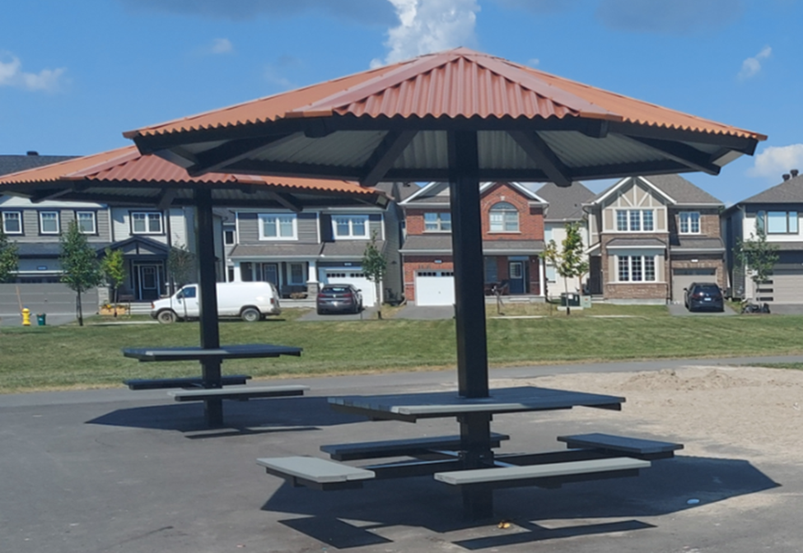
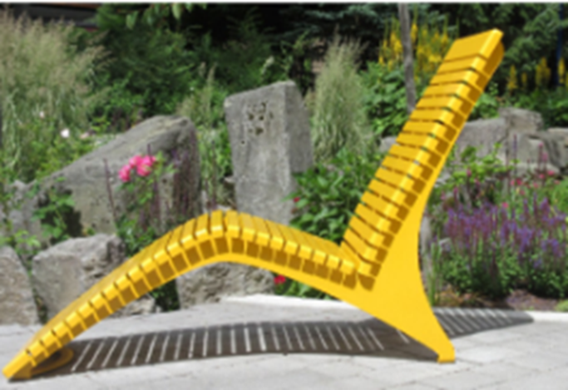
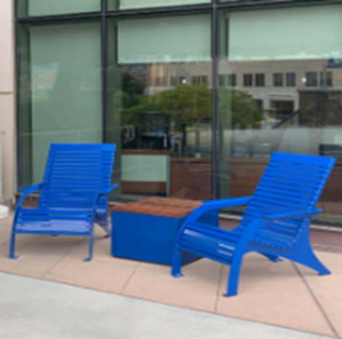
CPCA - Park Committee
2025
• Community survey on minor park improvements
Requests for more seating / tables
• Applied for Kitchissippi CILP funds – approved!
Installation TBA
Champlain Park Community Association

Slide 2
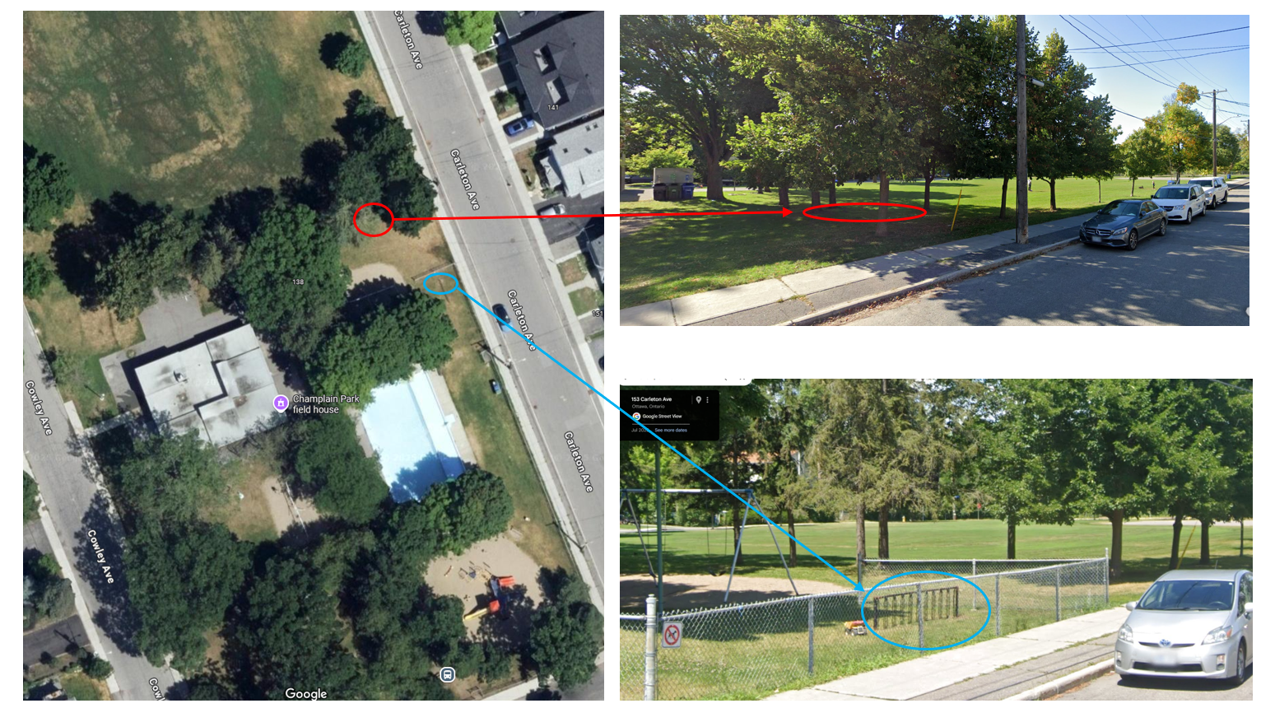
Location of installation
Champlain Park Community Association

Slide 3
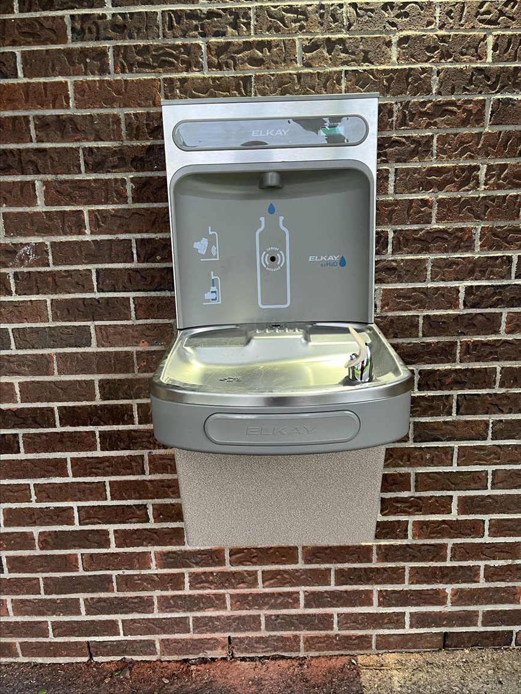
Fieldhouse Update
• New water fountain and bottle filling station
North side of fieldhouse
• Acoustic tile installation – work in progress!
Champlain Park Community Association

Slide 4
Planning Ahead: 2026
• Community Partnership Minor Capital Program
Plan to purchase 2–3 benches (likely west side, Cowley Avenue)
• Cost-sharing with City: 50% (up to $10-15K)
• Application due May 1, 2026 | Installation likely 2027
Champlain Park Community Association

