Slide 1
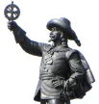
CPCA
Traffic Safety Committee
AGM Presentation
Nov 5, 2025

Slide 2
Agenda
Since our last AGM
Results of April 2025 Traffic Survey
Upcoming events

Slide 3
Since our last AGM
Survey sent out
Decline in traffic congestion on weekend probably due to shifting of NCC Bike Day hours
  Still noticing traffic congestion in the neighbourhood when events close the KZM
Reached out to Safer Roads Ottawa to organize upcoming Bike Rodeo and other events

Slide 4
Traffic Survey
Survey was live from April 15 to 30
The Traffic Safety Survey was an opportunity for residents to provide feedback in identifying traffic issues and problem areas within Champlain Park.
Residents were asked:
  Top 3 priorities of traffic related issues within CP
  Areas where issues were identified
  Changes you would like to see to increase traffic safety

Slide 5
Traffic Survey Results
We received 62 responses highlighting 163 issues
Summary:
  Cut-thru traffic and speeding are the biggest offenders
  By location, Clearview, Northwestern and Amanda Avenues are the main trouble spots
Note: Island Park Drive and Scott Street issues are not included but will not be ignored.

Slide 6
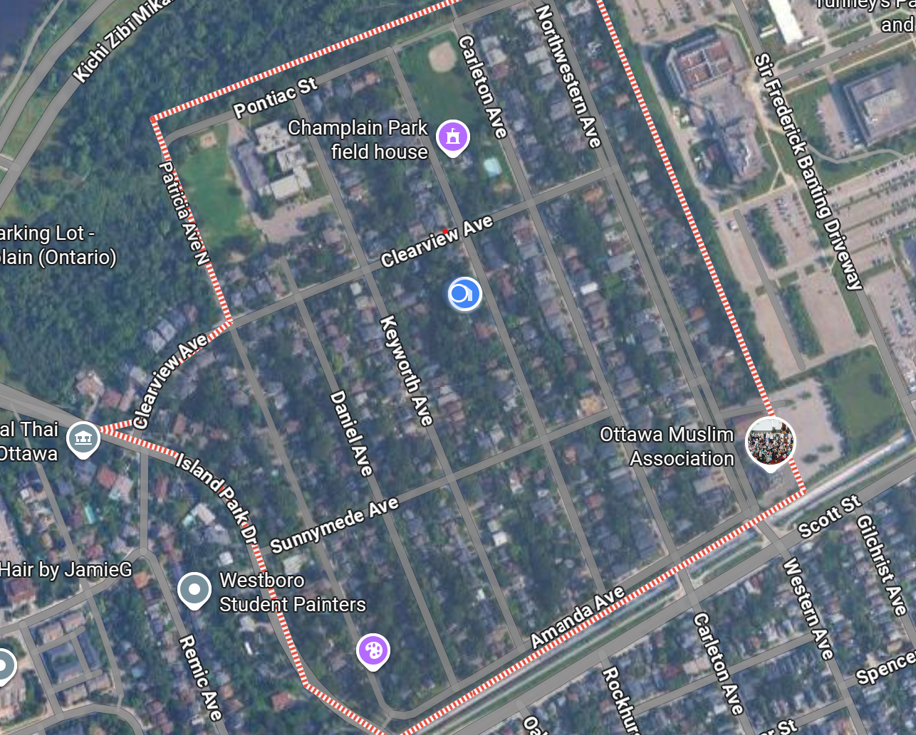
Traffic Survey
The focus of this survey was within our community boundaries:
  west of Tunney's Pasture,
  north of Scott Street,
  along the eastside of Island Park,
  south of the Kichi Zībī Mīkan.
Issues outside boundaries were pulled from the table but will not be discarded

Slide 7
Traffic Survey Results
Methodology
  Each response was reviewed and categorized
  Location was recorded where indicated
  Table was created to highlight issues and problem areas
  Submissions were reviewed as they were received
    Except a couple issues which were actually suggestions for change

Slide 8
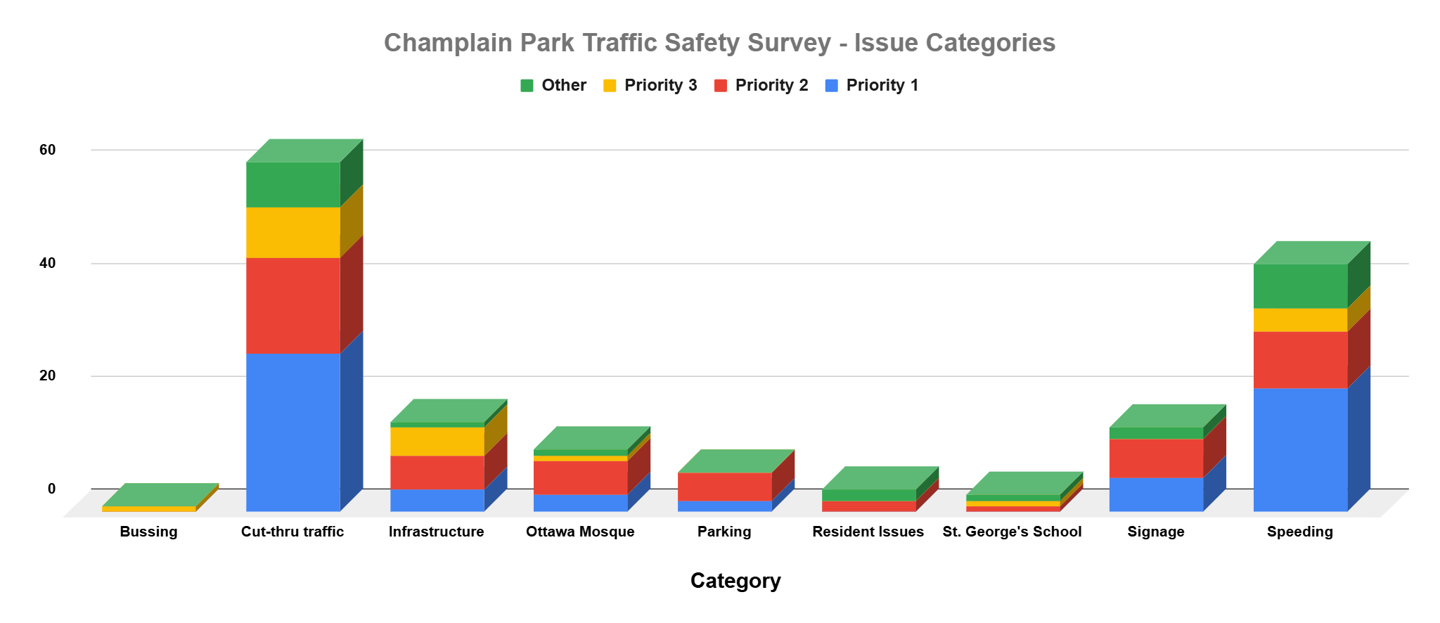

Slide 9
Traffic Survey Results
Issues Categories
  Bussing
    Only 1submission identified Bussing as an issue
    Not sure what we can do about this as it is really and OC Transpo matter

Slide 10
Traffic Survey Results
- Issues Categories (cont’d)
  Cut-thru Traffic
    By far the largest problem at 38% of issues identified
    Also Involves speeding and ignoring traffic laws
    Some commented that this has gotten better since the adjustment to NCC Bikeday hours

Slide 11
Traffic Survey Results
- Issues Categories (cont’d)
  Infrastructure
    General condition of the roads
    Lack of sidewalks
    Current traffic calming measures

Slide 12
Traffic Survey Results
- Issues Categories (cont’d)
  The Ottawa Mosque
    A mix of issues and kudos
    Issues are localized to the area of the Mosque itself
    Most of the issues stem around parking although speeding was also brought up

Slide 13
Traffic Survey Results
- Issues Categories (cont’d)
  Parking
    Currently an issue mostly surrounding the Mosque
    May be an issue to be monitored in the future with the Tunney’s Pasture redevelopment project

Slide 14
Traffic Survey Results
- Issues Categories (cont’d)
  Resident Issues
    Issues raised include hedges blocking views at intersections and cars driving the wrong way on roads
    Please inspect your properties to see if there something you can do to improve visibility at intersections

Slide 15
Traffic Survey Results
- Issues Categories (cont’d)
  St. George’s School
    Small percentage of identified
    Issue is with parents bringing their little ones to the school or the daycare
    Principal is very responsive to our concerns
      has reminded parents of students of the speed limit and need to obey traffic laws

Slide 16
Traffic Survey Results
- Issues Categories (cont’d)
  Speeding
    2nd biggest issue with 28% of the responses indicating speeding
    Those cutting through the neighbourhood are a big part of the perpetrators
    Some residents of CP are also guilty of speeding
      Reminder that the speed limit is 30km/h in CP

Slide 17
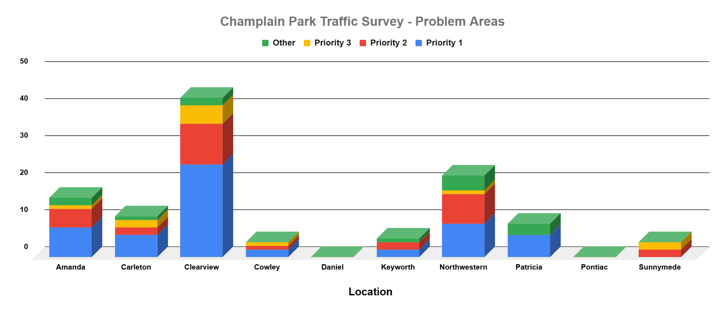

Slide 18
Survey Results
- Location
Most of the issues identified are on Clearview, Northwestern and Amanda
No street is immuned to the problems
One resident brought up a good point:
  Traffic calming strategies on one street leads to the issue moving to another street
  Something we need to consider when coming up with solutions

Slide 19
Suggested solutions
Greater enforcement
External traffic study needs to be done
Traffic cameras
A couple of locations were identified as needing 4-way stops
  Sunnymede/Keyworth
  Cowley/Carleton
More traffic calming measures

Slide 20
What’s Next
Traffic Safety Committee will meet in the near future to discuss findings and develop an action plan
Traffic blitz to back up what we’ve heard
Create a report for distribution to key influencers
  Jeff Lieper
  Ottawa Police Services
  Others?

Slide 21
Upcoming events
Traffic blitz to reinforce the concerns in the survey
Guest speaker on Traffic from an expert in the field
Hosting traffic safety events through Safer Roads Ottawa
  Bike rodeo in May 2026
  Traffic awareness campaign

Slide 22
Special Thanks
A special thanks to those who have signed up to be on the Champlain Park Traffic Safety Committee
We’re now a team of 8
New members welcome
And thanks to those who have been with me since the beginning

Slide 23
Thank you
Any comments or suggestions, please reach out at:
director4cpca@gmail.com
Bill Baggs
Chair, CP Traffic Safety Committee
613 325-2738

