Slide 1
Director Positions for November 5, 2025 CPCA Election
Meeting Chair |  | Nick Xenos
Secretary |  | Anita Saha
Finance/Membership/Risk Management | Chair | Lynne Bankier
Communications Committee | Chair | Laurie Fagan
Planning, Zoning and Environmental Policies | Chair | Heather Pearl
Environment Committee | Chair | Shelagh Jane Woods
Parks Committee | Chair | Joanne Chianello
Traffic Safety Committee | Chair | Bill Baggs
Social Committee | Chair | Nick Xenos
Fieldhouse | Coordinator | Laurie Fagan
Member at large | FCA General Meetings | Richard Lochead
Member at large | Webmaster, Technical | Alex Smith
Member at large | reserved for new member | Open
Champlain Park Community Association

Slide 2
Motion 1: To accept the revised and updated CPCA Articles of Incorporation
The CPCA Membership accepts the revised CPCA Articles of Incorporation with the following changes from the original Letters Patent (1991):
1. The original intent of the objectives is retained but wording is updated to improve clarity. (Section 2.2 in the revised By-Laws)
2. Number of Directors Range : ADD The Board will have a minimum of five (5) and a maximum of fifteen (15) Directors
3. There are two classes of membership: ADD
i) Resident Member: lives within the association's area of operation, has the right to vote at General Meetings and to serve as a director
ii) Associate Member: does not live within the association's area of operation, does not have voting rights at General
Meetings, or the right to serve as a director, but may enroll in activities and programs sponsored by the Association

Slide 3
Motion 2: To accept the revised and updated CPCA By-Laws (version 3A 2025 10 31)
Whereas, the revised CPCA By-Laws:
Comply with ONCA Ontario Not-for-Profit Corporations Act, 2010 Legislation that came into effect on
October 18, 2024
2. Are updated to reflect current operations & practices
Therefore, the CPCA Membership accepts the revised CPCA By-Laws.

Slide 4
Online Membership Drive May 1/24 to April 30/25
Resident Members
2024/25
170 Households Joined
309 Individual Members Listed within those households
2023/24
180 Households Joined
330 Individual Members Listed within those households
Approximate Number of Households in CP is 402
Note:
ONCA Legislation requires membership list by PERSON, not by household.
This change was incorporated starting with the 2023/24 online drive.
Data collection problem is that online membership form is not filled out by everyone, so number of individual members is under-counted

Slide 5
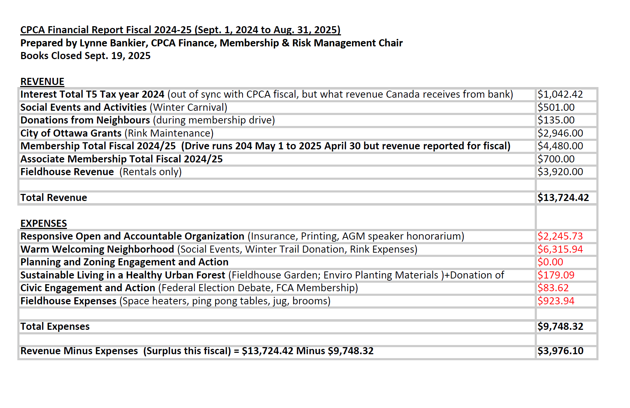

Slide 6
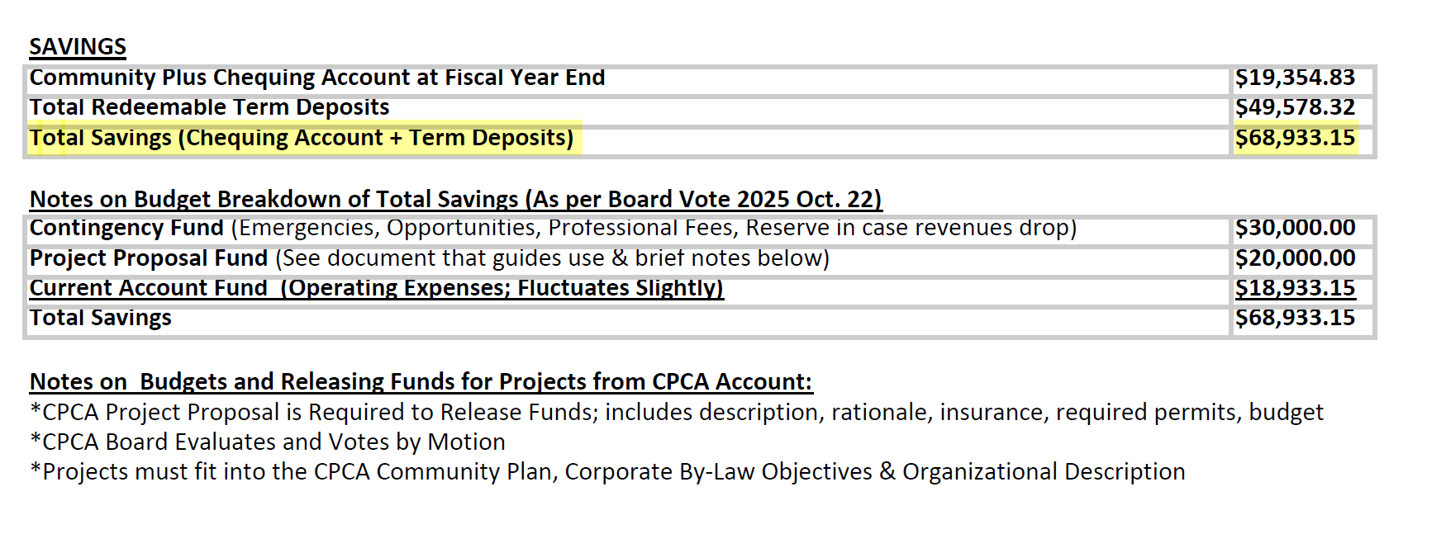

Slide 7
Motion to Waive an Audit:
Whereas CPCA is not required to conduct a financial audit (or review engagement) under the Ontario Not For Profit Corporations Act (ONCA) but requires a motion to waive (for transparency):
Therefore, the membership of CPCA waives both an audit and review engagement for the 2024/25 Financial Report.
CPCA Financial Procedures and Records
CPCA Board approval is required for project budgets
Receipts are required for reimbursement
Monies are kept in a deposit-insured credit union requiring 2 signatories to release funds (as specified in the By-Laws)
Financial Spreadsheets & Receipts are stored on the CPCA Google Drive

Slide 8
Community Project Proposals Eligibility
The Association’s monies must be reinvested to
support the corporation’s not-for-profit purposes
Proposals must fit into:
Community Plan
Our mission is to promote Champlain Park as a
welcoming, engaged and sustainable community
guided by the core interconnected goals defined by
the CPCA Community Plan:
1. A responsive, open and accountable
organization
2. A warm, welcoming neighbourhood
3. Planning and zoning engagement and action
4. Sustainable living in a healthy urban forest
5. Civic engagement and action
CPCA Objectives (Articles & By-Laws)
2.2 The objectives of the Association are:
a) developing and fostering community spirit
b) to foster involvement in the community by hosting
and supporting recreational, social, and educational
events and activities
c) providing a forum for presentation and discussion
of community interests and concerns
d) representing the interests of the community in the
association’s areas of activity and interest, as defined
in the by-laws, to government, tribunals and outside
organizations.
e) to cooperate with other community groups in the
area and in the city on shared issues

Slide 9
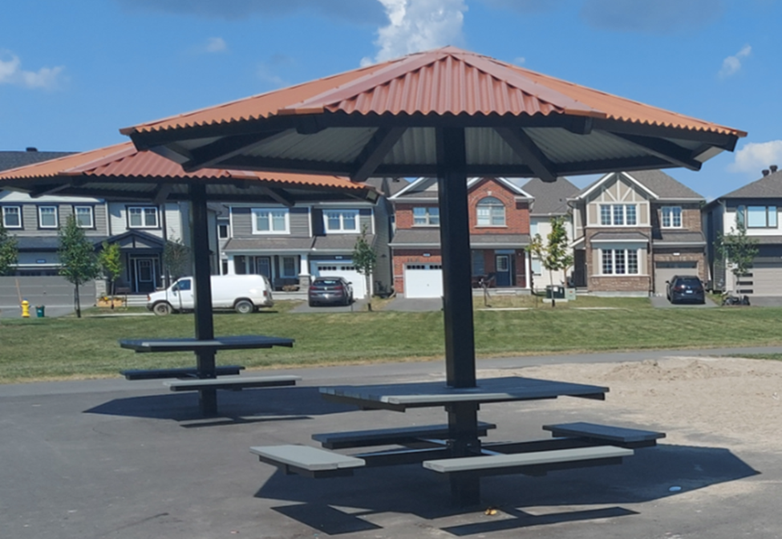
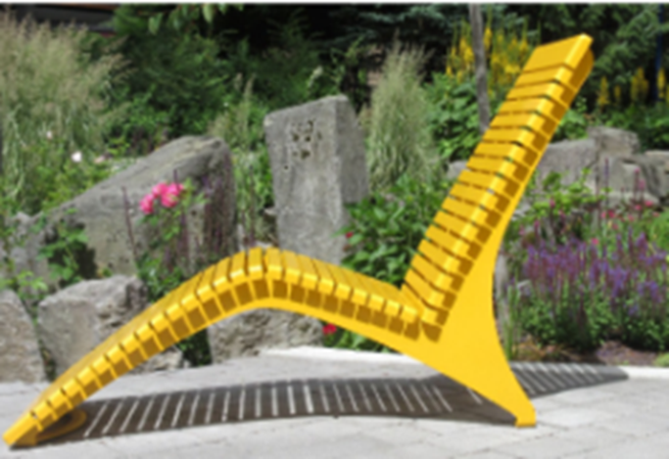
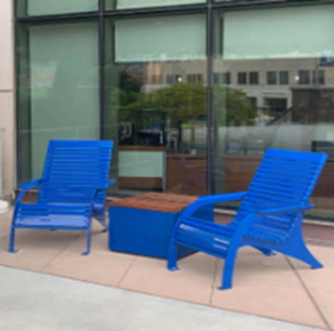
CPCA - Park Committee
2025
• Community survey on minor park improvements
Requests for more seating / tables
• Applied for Kitchissippi CILP funds – approved!
Installation TBA
Champlain Park Community Association

Slide 10
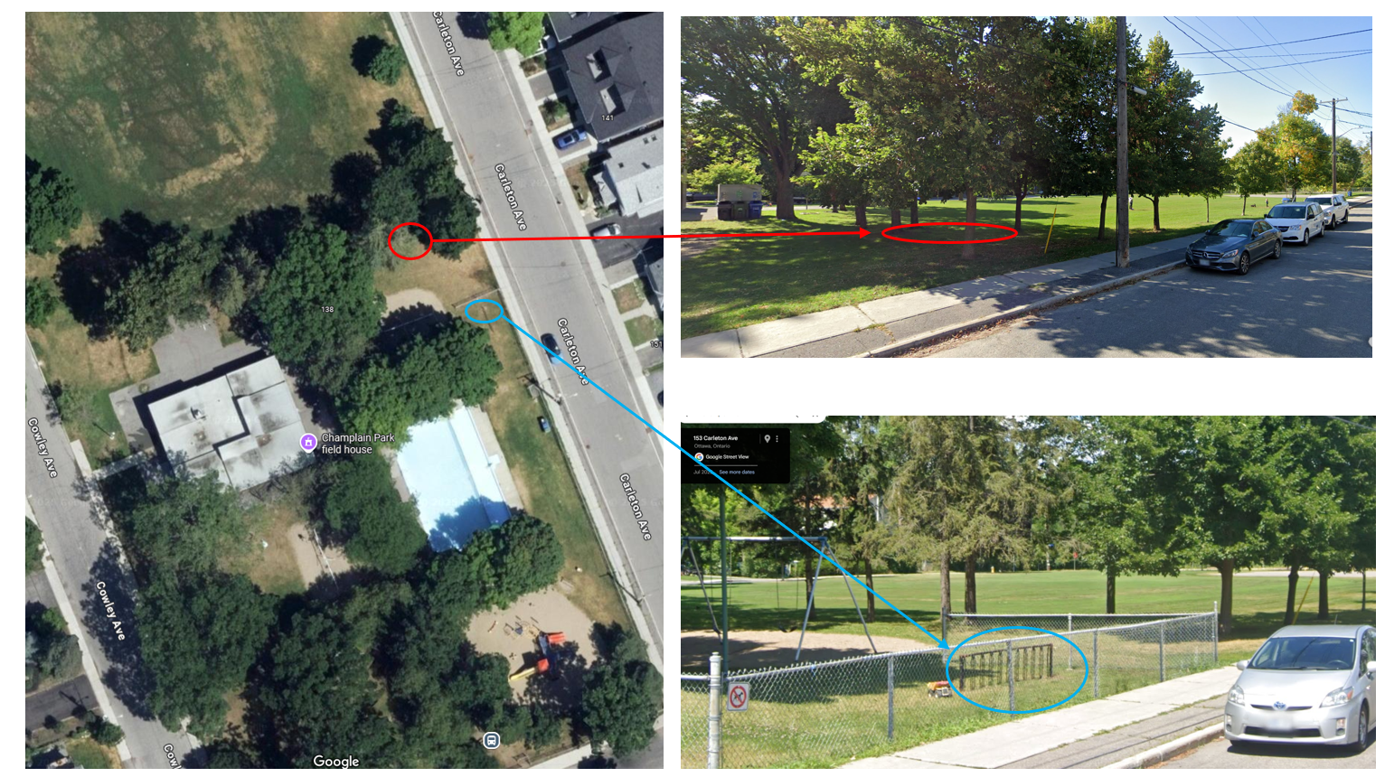
Location of installation
Champlain Park Community Association

Slide 11
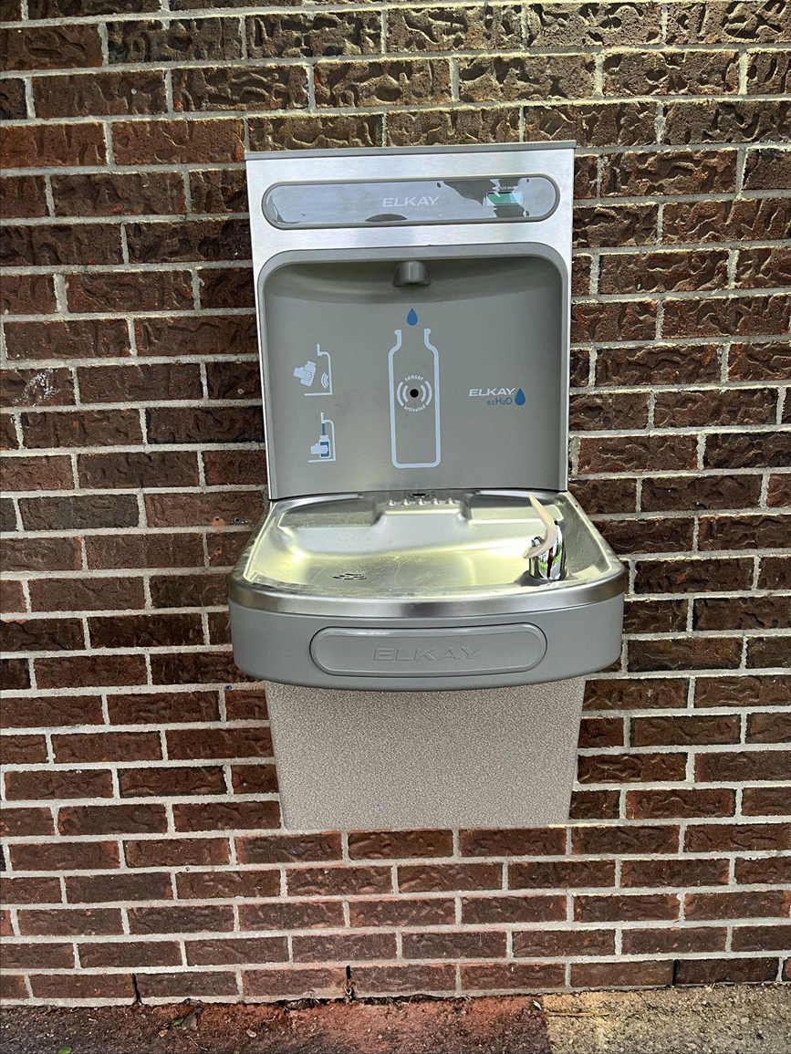
Fieldhouse Update
• New water fountain and bottle filling station
North side of fieldhouse
• Acoustic tile installation – work in progress!
Champlain Park Community Association

Slide 12
Planning Ahead: 2026
• Community Partnership Minor Capital Program
Plan to purchase 2–3 benches (likely west side, Cowley Avenue)
• Cost-sharing with City: 50% (up to $10-15K)
• Application due May 1, 2026 | Installation likely 2027
Champlain Park Community Association

Slide 13

CPCA
TRAFFIC SAFETY COMMITTEE
AGM PRESENTATION
NOV 5, 2025

Slide 14
AGENDA
Since our last AGM
Results of April 2025 Traffic Survey
Upcoming events

Slide 15
SINCE OUR LAST AGM
Survey sent out
Decline in traffic congestion on weekend probably due to shifting of NCC Bike Day hours
  Still noticing traffic congestion in the neighbourhood when events close the KZM
Reached out to Safer Roads Ottawa to organize upcoming Bike Rodeo and other events

Slide 16
TRAFFIC SURVEY
Survey was live from April 15 to 30
The Traffic Safety Survey was an opportunity for residents to provide feedback in identifying traffic issues and problem areas within Champlain Park.
Residents were asked:
  Top 3 priorities of traffic related issues within CP
  Areas where issues were identified
  Changes you would like to see to increase traffic safety

Slide 17
TRAFFIC SURVEY RESULTS
We received 61 responses highlighting approximately 150 issues
Summary:
  Cut-thru traffic and speeding are the biggest offenders
  By location, Clearview, Northwestern and Amanda Avenues are the main trouble spots
Note: Island Park Drive and Scott Street issues are not included but will not be ignored.

Slide 18
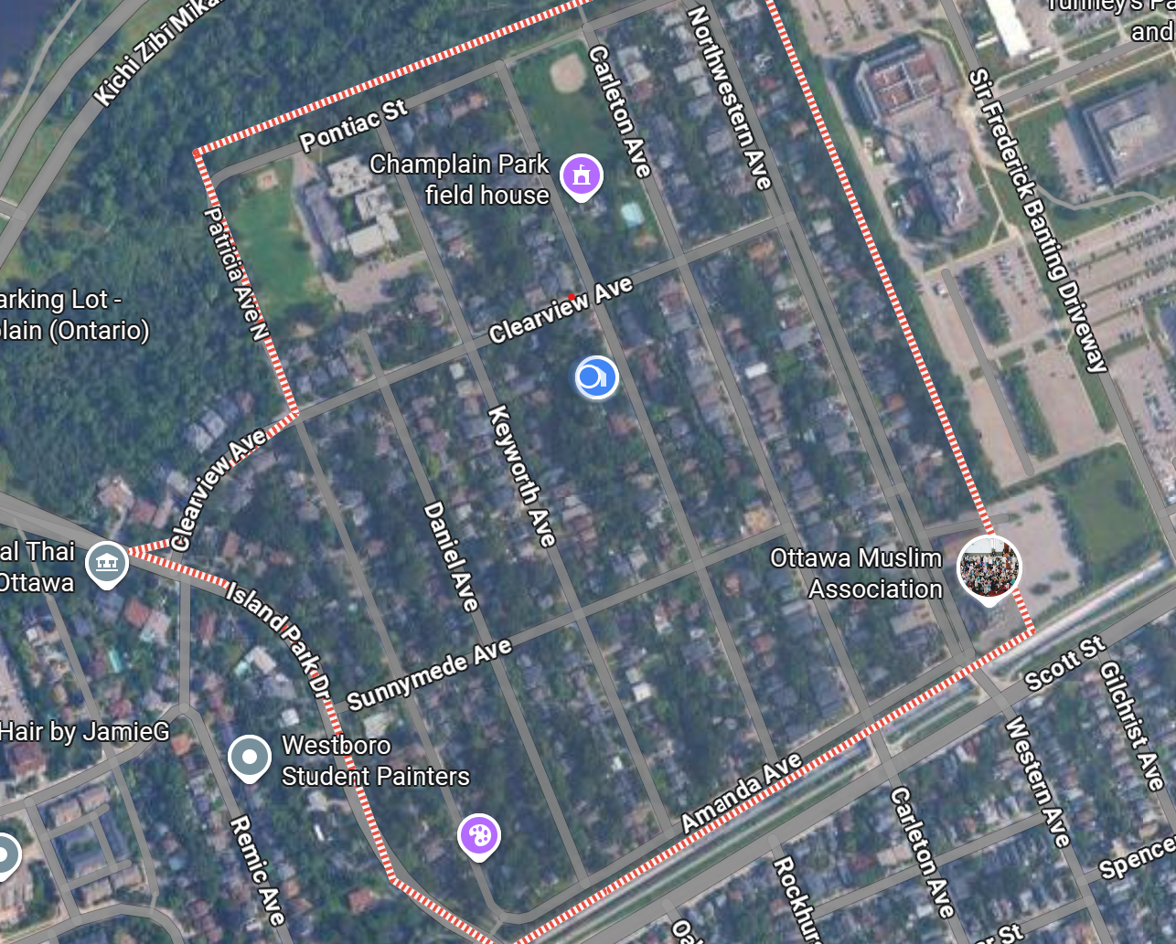
TRAFFIC SURVEY
The focus of this survey was within our community boundaries:
  west of Tunney's Pasture,
  north of Scott Street,
  along the eastside of Island Park,
  south of the Kichi Zībī Mīkan.
Issues outside boundaries were pulled from the table but will not be discarded

Slide 19
TRAFFIC SURVEY RESULTS
METHODOLOGY
  Each response was reviewed and categorized
  Location was recorded where indicated
  Table was created to highlight issues and problem areas
  Submissions were reviewed as they were received
    Except a couple issues which were actually suggestions for change

Slide 20
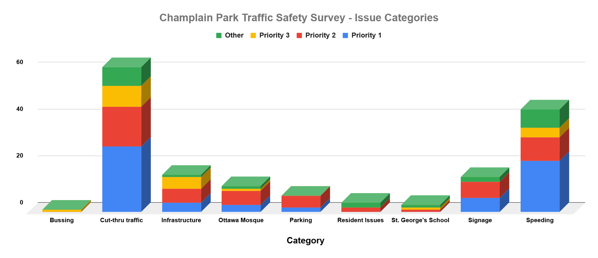

Slide 21
TRAFFIC SURVEY RESULTS
ISSUES CATEGORIES
  Bussing
    Only 1submission identified Bussing as an issue
    Not sure what we can do about this as it is really and OC Transpo matter

Slide 22
TRAFFIC SURVEY RESULTS
- ISSUES CATEGORIES (CONT’D)
  Cut-thru Traffic
    By far the largest problem at 38% of issues identified
    Also Involves speeding and ignoring traffic laws
    Some commented that this has gotten better since the adjustment to NCC Bikeday hours

Slide 23
TRAFFIC SURVEY RESULTS
- ISSUES CATEGORIES (CONT’D)
  Infrastructure
    General condition of the roads
    Lack of sidewalks
    Current traffic calming measures

Slide 24
TRAFFIC SURVEY RESULTS
- ISSUES CATEGORIES (CONT’D)
  The Ottawa Mosque
    A mix of issues and kudos
    Issues are localized to the area of the Mosque itself
    Most of the issues stem around parking although speeding was also brought up

Slide 25
TRAFFIC SURVEY RESULTS
- ISSUES CATEGORIES (CONT’D)
  Parking
    Currently an issue mostly surrounding the Mosque
    May be an issue to be monitored in the future with the Tunney’s Pasture redevelopment project

Slide 26
TRAFFIC SURVEY RESULTS
- ISSUES CATEGORIES (CONT’D)
  Resident Issues
    Issues raised include hedges blocking views at intersections and cars driving the wrong way on roads
    Please inspect your properties to see if there something you can do to improve visibility at intersections

Slide 27
TRAFFIC SURVEY RESULTS
- ISSUES CATEGORIES (CONT’D)
  St. George’s School
    Small percentage of identified
    Issue is with parents bringing their little ones to the school or the daycare
    Principal is very responsive to our concerns
      has reminded parents of students of the speed limit and need to obey traffic laws

Slide 28
TRAFFIC SURVEY RESULTS
- ISSUES CATEGORIES (CONT’D)
  Speeding
    2nd biggest issue with 28% of the responses indicating speeding
    Those cutting through the neighbourhood are a big part of the perpetrators
    Some residents of CP are also guilty of speeding
      Reminder that the speed limit is 30km/h in CP

Slide 29
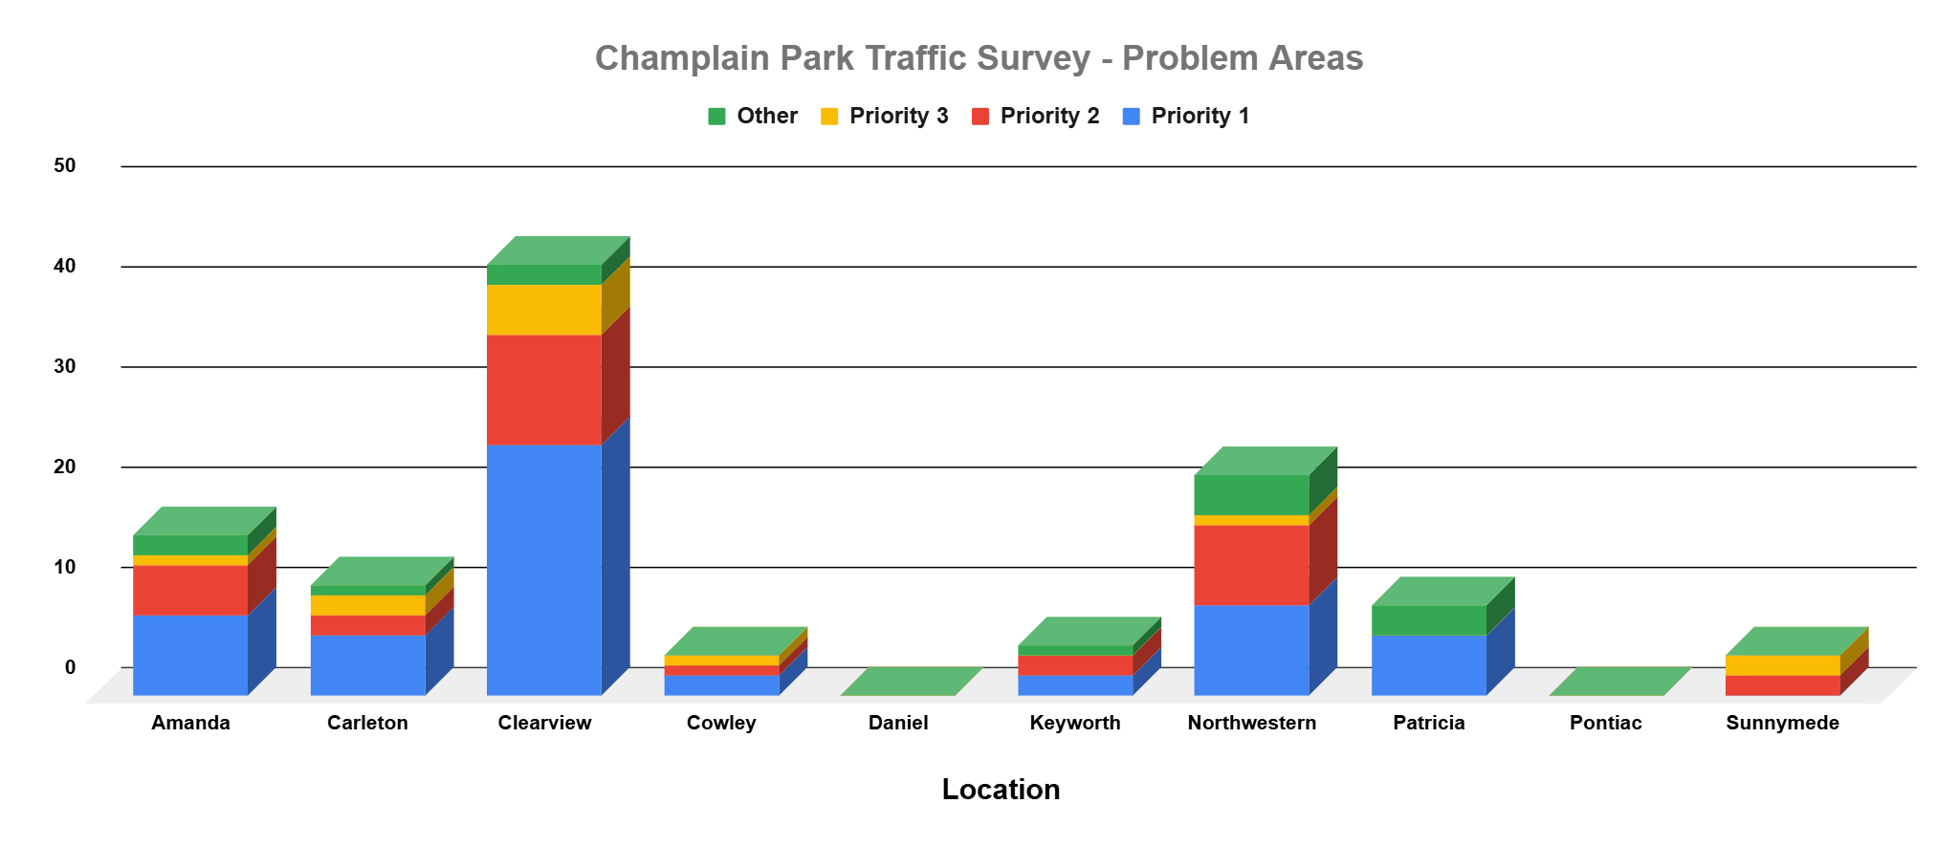

Slide 30
SURVEY RESULTS
- LOCATION
Most of the issues identified are on Clearview, Northwestern and Amanda
No street is immuned to the problems
One resident brought up a good point:
  Traffic calming strategies on one street leads to the issue moving to another street
  Something we need to consider when coming up with solutions

Slide 31
SUGGESTED SOLUTIONS
Greater enforcement
External traffic study needs to be done
Traffic cameras
A couple of locations were identified as needing 4-way stops
  Sunnymede/Keyworth
  Cowley/Carleton
More traffic calming measures

Slide 32
WHAT’S NEXT
Traffic Safety Committee will meet in the near future to discuss findings and develop an action plan
Traffic blitz to back up what we’ve heard
Create a report for distribution to key influencers
  Jeff Lieper
  Ottawa Police Services
  Others?

Slide 33
UPCOMING EVENTS
Traffic blitz to reinforce the concerns in the survey
Guest speaker on traffic from an expert in the field
Sign campaign for safer streets = safer community
Hosting traffic safety events through Safer Roads Ottawa
  Bike rodeo in May 2026
  Traffic awareness campaign

Slide 34
SPECIAL THANKS
A special thanks to those who have signed up to be on the Champlain Park Traffic Safety Committee
We’re now a team of 8
New members welcome
And thanks to those who have been with me since the beginning

Slide 35
THANK YOU
Any comments or suggestions, please reach out at:
director4cpca@gmail.com
Bill Baggs
Chair, CP Traffic Safety Committee
613 325-2738

Slide 36
NOTABLE SURVEY SUBMISSION
“I honestly think it is a matter of time before someone is seriously injured or killed in our neighbourhood by a car.”

Slide 37
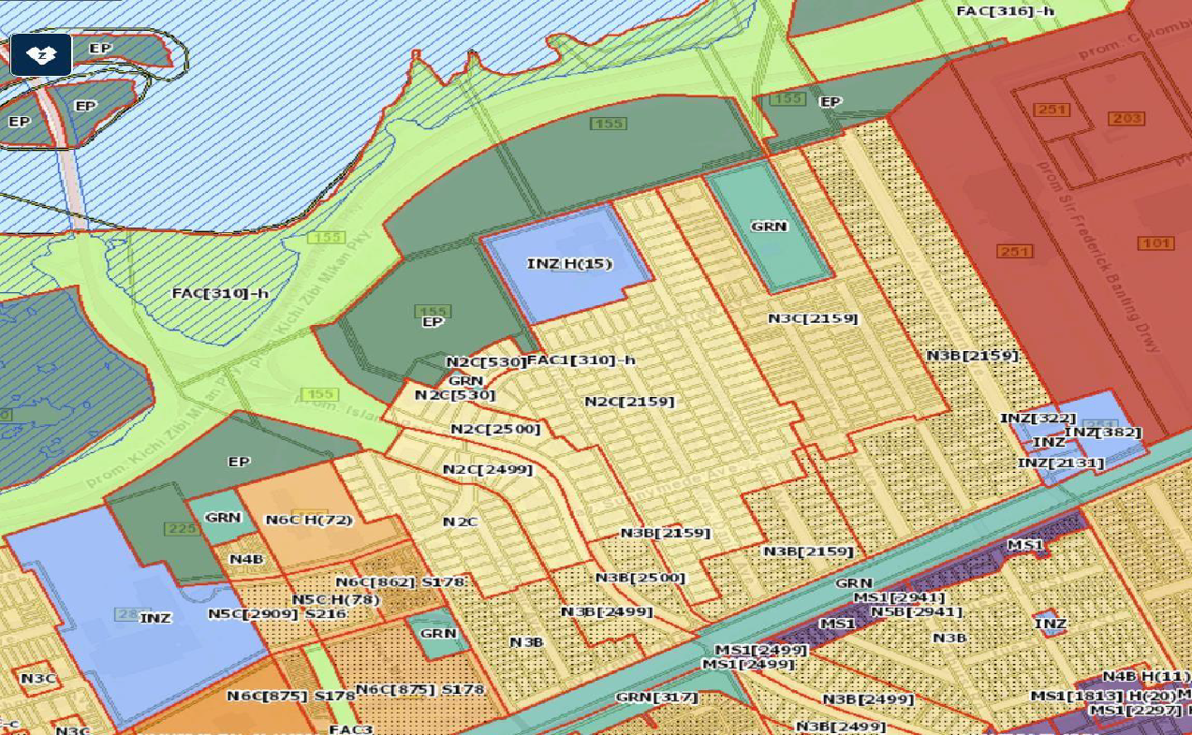
Champlain Park Community Association (1991 Ontario) Ont/Corp # 000923164
Comments: New Zoning Bylaw – Draft 2 June 29, 2025
Champlain Park Community Association

Slide 38
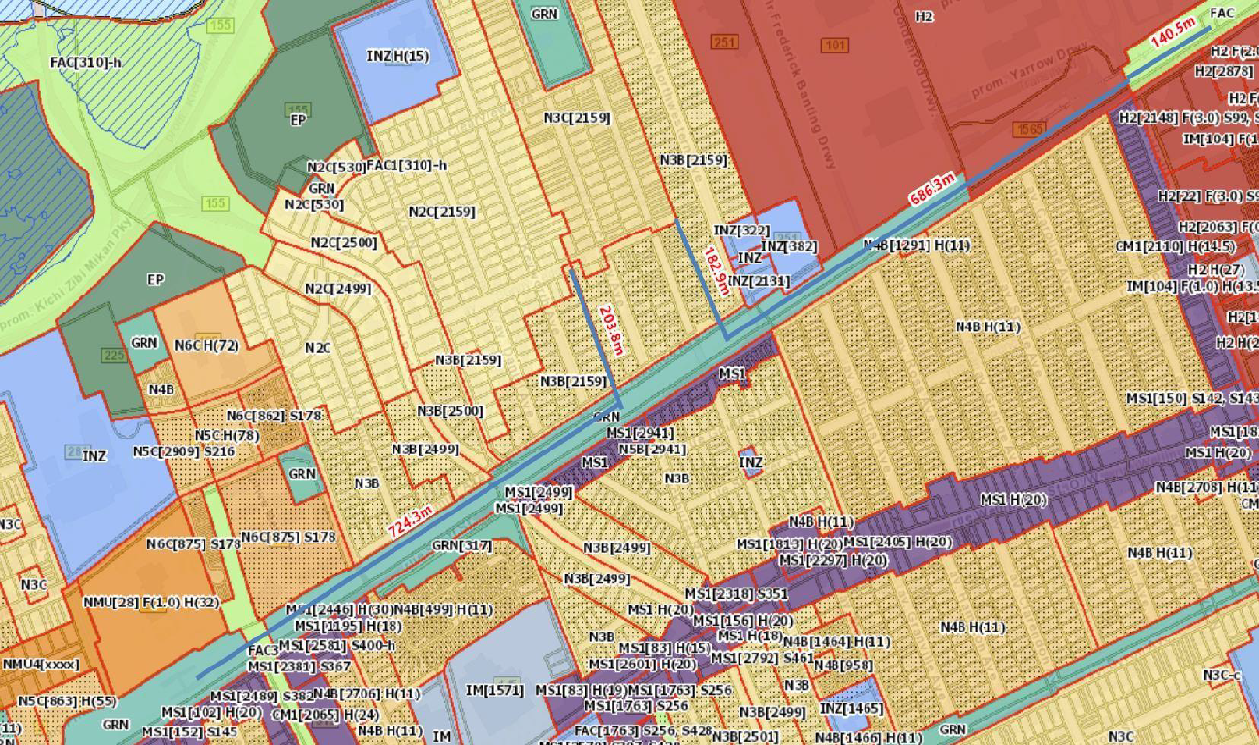
2- Neighbourhood Interior Zoning: Applicability of N3C zoning
Champlain Park Community Association

Slide 39
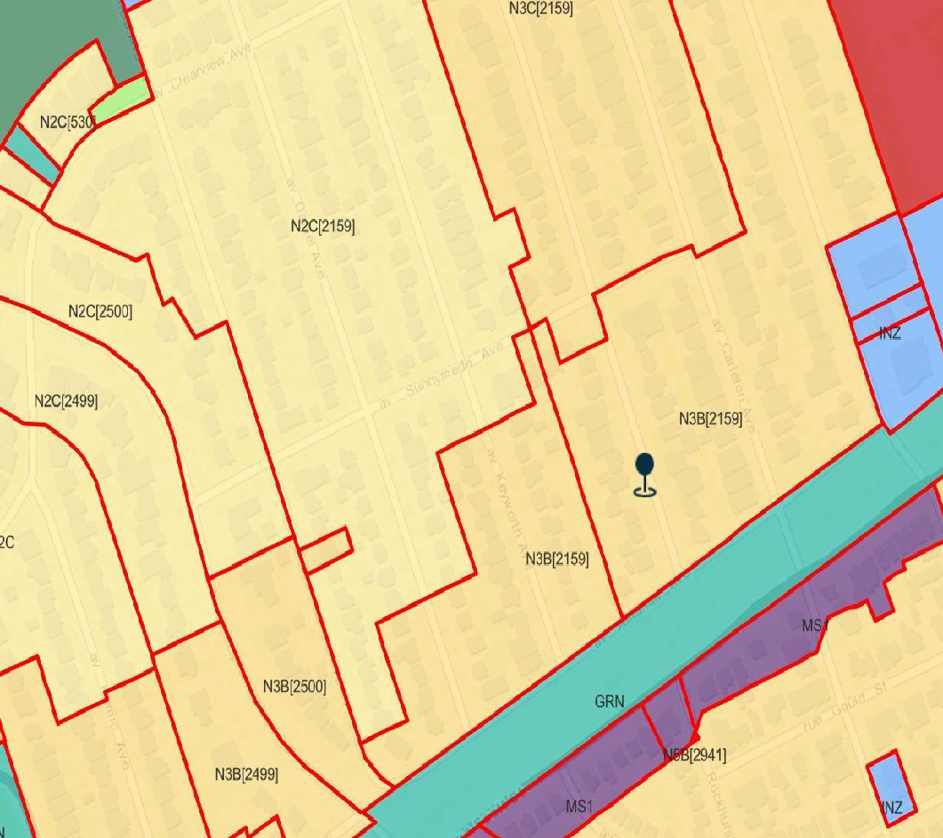
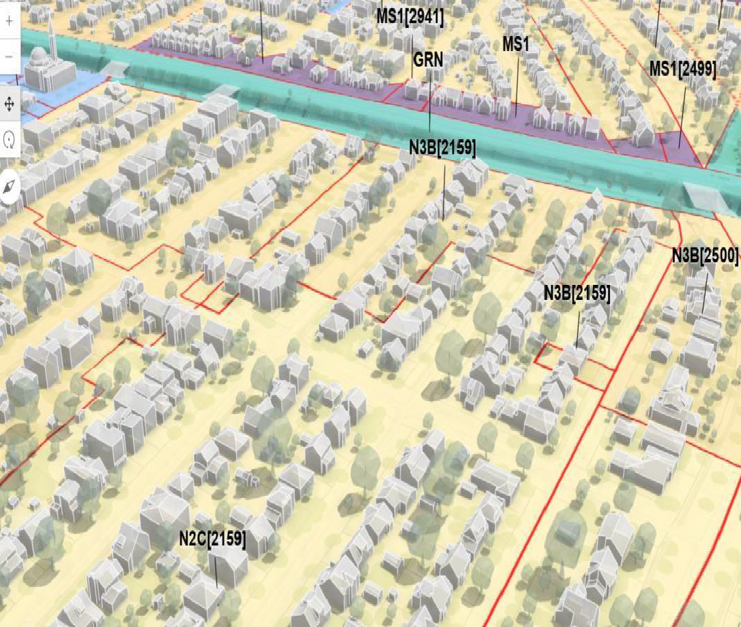
3. Inconsistently zoned lots on Patricia Avenue and Sunnymede Avenue
3.1 Why is 241 Patricia Avenue in the south block of Patricia Ave. singled out for higher density zoning, at N3B (2159), than all of the surrounding lots?

Slide 40
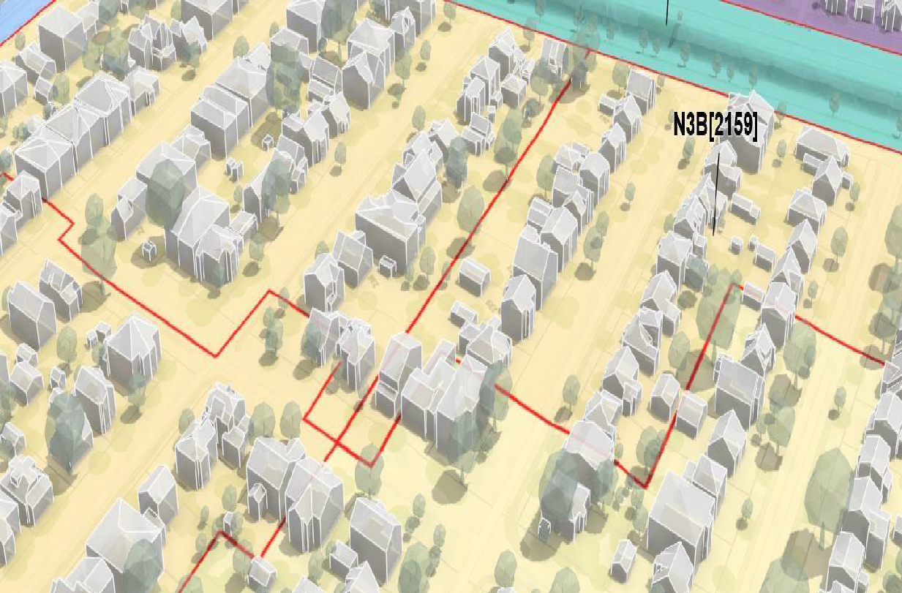
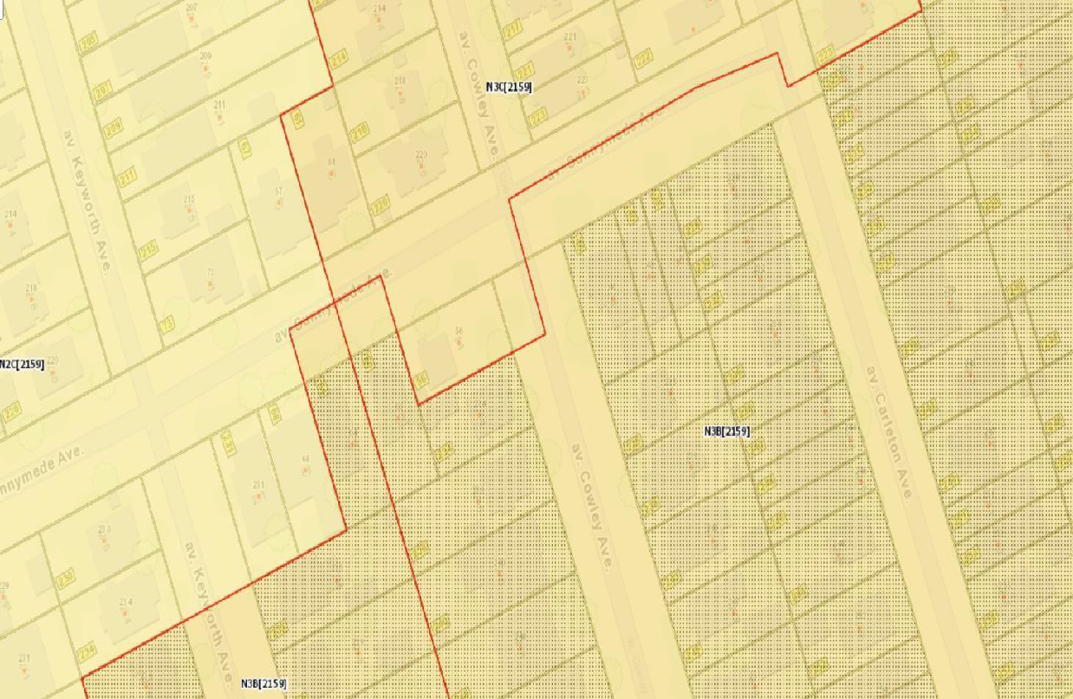
3.2 Why does the boundary along Sunnymede Avenue, jog along the north side of the street between Keyworth and Carleton Avenues? Zig-zag zoning on this section of Sunnymede between Keyworth and Carleton Avenues seems needlessly complicated
Champlain Park Community Association

Slide 41

Kitchissippi Questions re: Parkland designations in ZBL Draft 2, Scott St. from NCC lands to Tunney’s Pasture Station GRN designations, Exception 317 and Scott St. / LRT corridor
1 of 3 H. Pearl, July 1, 2025
1) GRN Exception 317 designation, Heather Crowe Park, dedicated in 2009

Slide 42
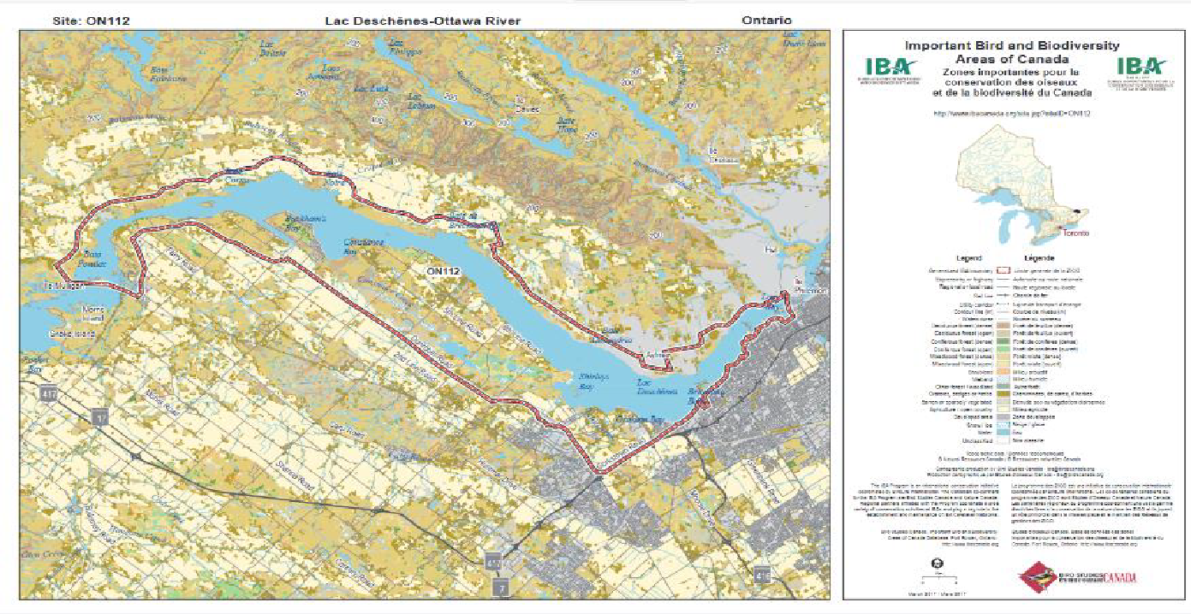
Important Bird Area – A Globally Significant Area
The IBA Program is an international conservation initiative coordinated by BirdLife International. The Canadian co-partners for the IBA Program are Birds Canada and Nature Canada. : https://www.ibacanada.org/site.jsp?siteID=ON112
Champlain Park Community Association

Slide 43
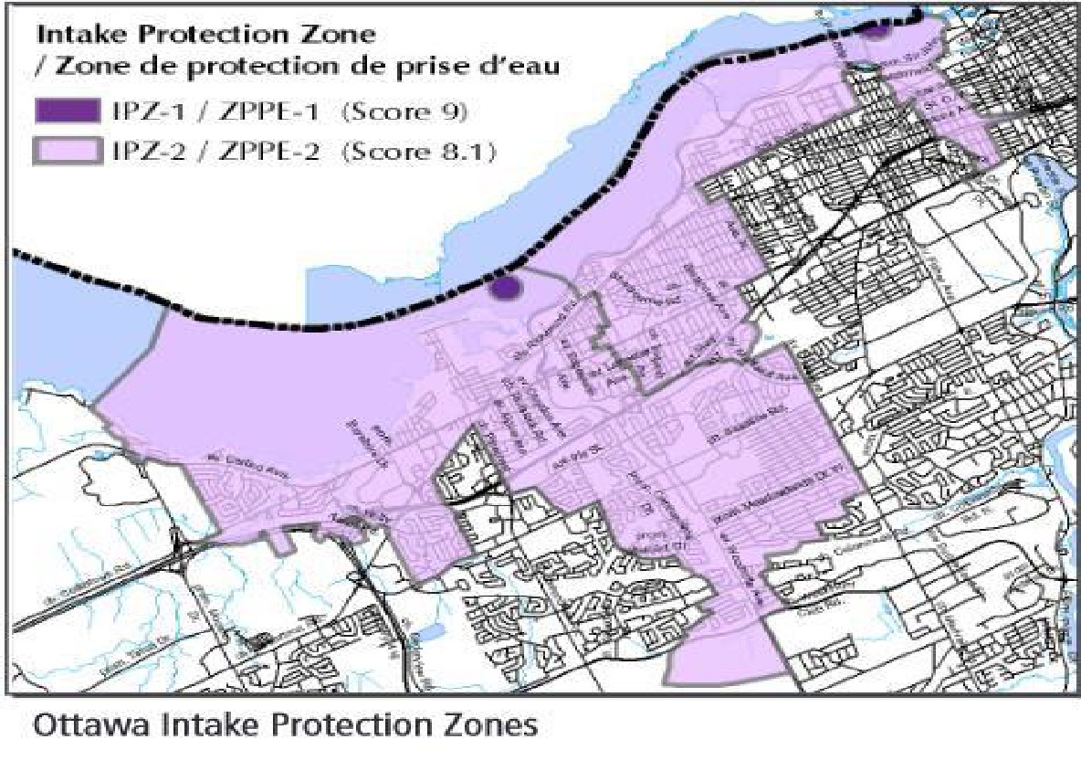
Everyone Lives on a Watershed. Problems with Water Start with the Land

Slide 44
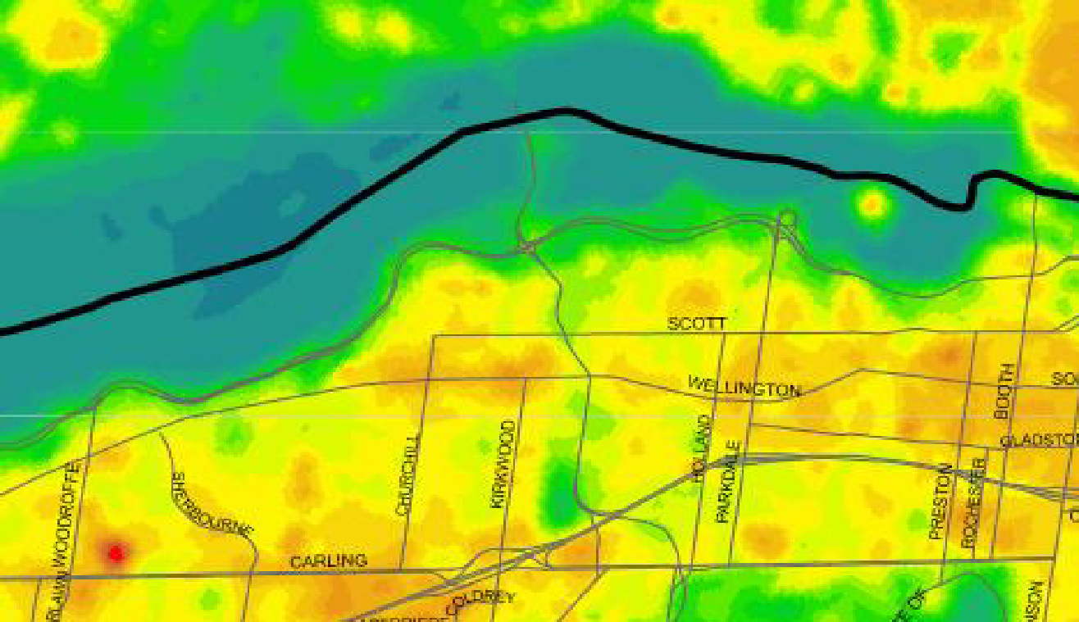
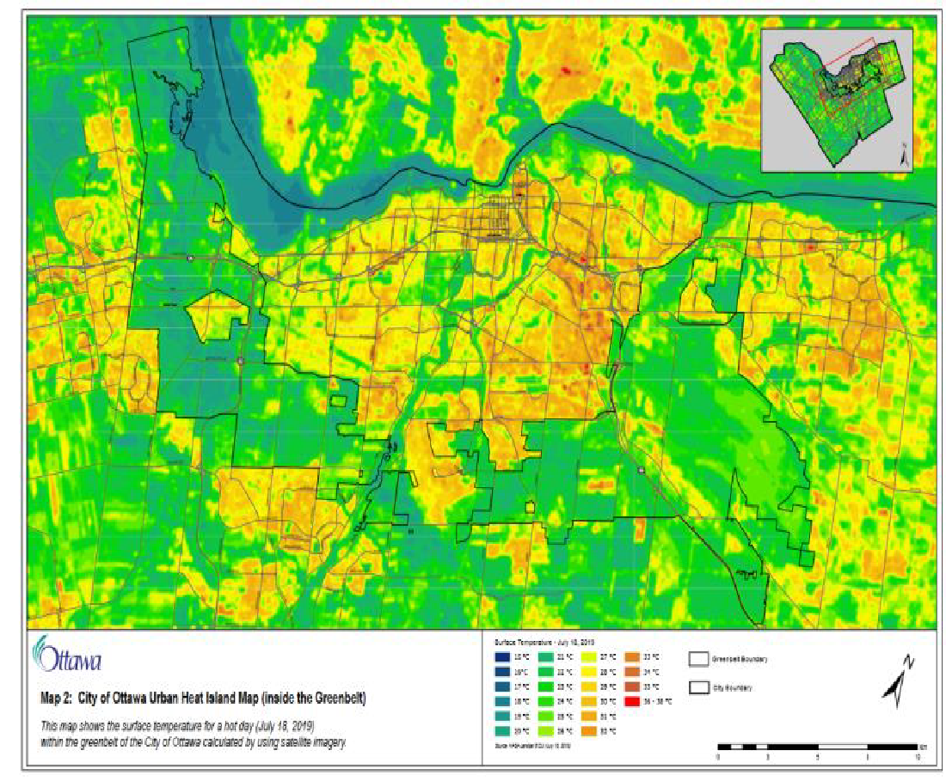
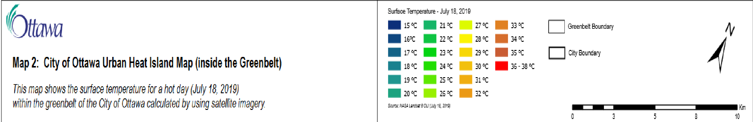
Kitchissippi Heat Island, July 18, 2019
Champlain Park Community Association

